Slide 1
Project: Date-A-Scientist
Machine Learning Fundamentals
Oleg Vakhromov
November 25, 2018

Slide 2
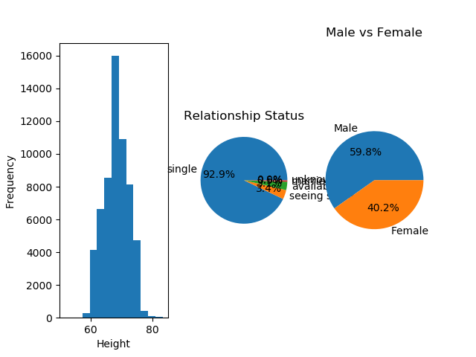
Visualizing data
I was exploring features that could be later used in the project.
There were no anomalies detected in the data set. Heights are normally distributed, as expected majority of profiles are for single people. There is a small bias toward males in the sample. Which is also understandable.
Questions I am interested in:
1. Can we predict sex of the person based on word count of 'My self summary' section and level of income?
2. Is there a bias in salaries? Meaning, can we predict sex of the person based on salary alone?

Slide 3
Augmenting data
I've created two additional columns:
1. “Sex_code” where the original values of “m” and “f” were converted to 0 and 1 respectively
2. “Essay_word_cnt” that contains number of words used in the essay question #1 “My self summary”

Slide 4
Findings
I've used both classification and regression methods to create predictions. Here are my findings:
Classification methods
SVM score was: 0.5939115929941619 and took 83.345 seconds to compute
Naive Bayes score was: 0.5939115929941619 and took 0.016 seconds to compute
Regressions
Predicting sex based on level of income yielded the score of : 0.00601
Predicting sex based on level of income and length of "About Me" essay yielded the score of : 0.00723
We can clearly see based on the accuracy score that Classification methods yield much better result. Naive Bayes method is by far the fastest method. I believe that the result could be imporved if the data set was cleared of lines containing 0 income.

